Slide 1
Pathophysiology and Therapeutics: Nutrition
Lawrence Carey, PharmD
Temple University School of Pharmacy

Slide 2
Objectives
Define malnutrition
List the adverse effects associated with nutritional deficiencies
Evaluate and assess a patient for malnutrition
Explain the differences, advantages, and disadvantages of different methods of nutritional support
List the basic components of a nutrition formulation
Develop a nutritional plan, including caloric goals, fluid goals, and protein, carbohydrate and lipid requirements
Identify complications of nutritional support therapy
Identify appropriate monitoring parameters

Slide 3
The Basics
Macronutrients
Micronutrients
Protein (AA)
Carbohydrates (CHO)
Fat (FFA)
Fluids*
*not a macronutrient but essential
Electrolytes
Vitamins
Minerals

Slide 4
The Basics
Macronutrients:
Protein: provided as amino acids
CHO: provided as dextrose
Fat: provided as lipids
Calories (as kilocalories): provided by all 3 macronutrients
Total caloric needs can vary greatly
Fluids: provided as sterile water with electrolytes

Slide 5
Nutrient Requirements: Calories
Estimate by kcals/kg/day*
Basal | 20-25 kcal/kg/day
Healthy, normal nutritional status | 25 kcal/kg/day
Malnourished, mild metabolic stress | 28 kcal/kg/day
Malnourished, moderate metabolic stress | 30 kcal/kg/day
Critically ill, hypermetabolic | 30-35 kcal/kg/day
Major burn injury | 40 kcal/kg/day
*If patient has BMI > 30, adjusted body weight should be used
Rollins CJ. In Applied Therapeutics: 10th Edition, 2013.
A.S.P.E.N Board of Directors and the Clinical Guideline Task Force. Guidelines for the use of parenteral and enteral nutrition in adult and pediatric patients. JPEN 2002;26:9SA-12SA.

Slide 6
Fluid Requirements
Increased fluid requirements
Fever, sweating
Increased respiratory rate
Hyperthyroid, hypermetabolic
Drains, fistulas
Decreased fluid requirements
Renal failure (if fluid overloaded)
Heart failure
Cirrhosis with severe ascites
Fluid
Fluid
or hyponatremia (Na < 120)

Slide 7
Fluid Requirement
Daily Maintenance
Fluid Requirement
= 1500 mL + 20 mL (# of kg over 20kg)
Example: What is the fluid requirement of a female weighing 155 pounds?
Step1: 155 pounds = 70.5 kg
Usually round to the nearest 100mL
Step2: 1500 mL + 20 mL (70.5 kg – 20 kg)
Step2: 1500 mL + 20 mL (50.5 kg)
Step3: 1500 mL + 1010 mL = 2510 mL = 2500 mL
= 2100 mL
OR…can use an estimate of 30 mL/kg/day

Slide 8
Micronutrients
Electrolytes
Sodium, potassium, calcium, magnesium, phosphate, chloride, acetate
Vitamins
Given as MVI
A, D, E, K; B vitamins, C, folic acid
Minerals
Given as MTE products
Copper, zinc, chromium

Slide 9
Single Micronutrient Deficiencies
Folic acid → megaloblastic anemia
Vitamin A → night blindness
Vitamin D → osteomalacia, rickets
Thiamine → Wernicke/Korsakoff
Zinc → poor wound healing
Vitamin K → coagulopathy

Slide 10
Malnutrition and Nutritional Assessment

Slide 11
Definition of Malnutrition
Refers to both undernutrition and overnutrition
Inadequate intake of calories and protein for maintenance and growth; cannot fully utilize food eaten due to illness
Also defined as the insufficient, excessive or imbalanced consumption of nutrients.
WHO: is the gravest single threat to global public health
ASPEN: “Well nourished adults without excessive metabolic stress can usually tolerate little to no nutrition for up to 7 days”
Three categories of malnutrition:
Marasmus, kwashiorkor, mixed

Slide 12
Classifications of Malnutrition
Marasmus: prolonged inadequate intake of protein and calories
Weight loss > 10% of TBW
Albumin/transferrin may be normal
Patients look starved and wasting
Kwashiorkor: inadequate protein and micronutrient intake (rare)
Albumin not normal, see edema
Elderly, child neglect
Mixed protein-calorie malnutrition (common)
See more acutely (i.e., burns, chronically ill)

Slide 13
Reasons for Malnutrition
↓ Intake
↑ Demand
Not eating
Poor appetite
N/V
Difficulty swallowing
Poor absorption
Severe diarrhea
Bowel obstruction
Bowel resection
Inflammation
Hypermetabolic
Sepsis
Infection
Trauma
Burn
Wound repair
Post-op
Trauma

Slide 14
↓ Intake
↑ Demand
Malnutrition
Cause
Effect
↑ Cost of care
↑ Mortality
and morbidity
Organ & muscle
wasting
↓ Immune system
function
↑ Hospital LOS and
complications
A.S.P.E.N Board of Directors and the Clinical Guideline Task Force. Guidelines for the use of parenteral and enteral nutrition in adult and pediatric patients. JPEN 2002;26:9SA-12SA.
Notes:
Deficiency of energy intake (Marasmum) usually results in wasting of adipose tissue (subQ) fat and somatic proteins (skeletal muscle). Visceral protien (from liver) is reserved. Cachectic appearance. Typically cancer, AIDS patients have this syndrome
Increased demand is a result of increased metabolic demand secondary to catabolic stress from trauma, infection, or burns. There is a deficiency of visceral protein, and usually results from protein deprivation in the setting of metabolic stress.
Malnutrition is defined as any disorder of nutrition status: deficiency of nutrient intake, impaired nutrient metabolism or absorption, or over-nutrition.

Slide 15
Malnutrition
↓ Intake/utilization of food
↑ Metabolism/catabolism
Breakdown of endogenous sources of energy
(protein and stored fat)
Increased breakdown and use of exogenous nutrients and endogenous nutrient stores
(Usually associated with protein deficiency)
Skeletal muscle wasting
&
Subcutaneous fat wasting
Decrease protein synthesis; impaired immune function; decreased albumin & edema are common
Weight loss, cachexia; impaired muscle function, organ function, and immune function
Notes:
Acute trauma, illness, or stress increases your body’s energy needs to repair tissues, maintain functions

Slide 16
Malnutrition-Inducing Diseases
Associated with specific disease states
Cancer
AIDS
Critical Illness
Inflammatory bowel disease
Short bowel syndrome

Slide 17
Nutrition Assessment
Nutrition Screening
(Within 24 hr, every 7-14 days)
Identify patients at risk of malnutrition
Utilizes primary diagnosis, diet history, and weight history
Nutrition Assessment
Patient History
Medical conditions
Dietary habits
Social history
Medications
Physical Exam
Anthropometrics
Muscle wasting/fat wasting
Fluid status and edema
Skin, hair, nails
Mouth – glossitis, cheilosis
Measurement of subcutaneous fat and skeletal muscle mass
Notes:
Nutritional screening is a tool used to identify patients that may be candidates for a more formal nutritional assessment. It is a good idea to assess elderly patients as they are at higher risk of malnutrition secondary to commonly found comorbidities: eating/swallowing difficulties, depression, decreased appetite, functional disabilities, impaired taste and smell.
Patient history- history of medical conditions that can lead to/cause malnutrition (as stated above). Also may include a recent history of severe diarrhea and/or vomiting, speech/swallowing difficulty, arthritis, weakness or muscle pain, weight loss, anorexia, decreased po intake.
Dietary habits- anorexia, bulimia, dietary supplements (Ensure, glucerna, etc)
Social History- EtOH abuse (prone to nutritional disorders and vitamin/mineral deficiencies secondary to poor intake, specifically thiamine and folate)
Medications – use of laxatives, GI motility agents, diuretics. Altered appetite, taste, absorption, or metabolism of nutrients.
Physical Exam
Fluid status- edema, ascites may be a sign of low albumin. Dehydration may be a sign of poor PO intake
Skin changes – “dermatitis,” thin, scaly, shiny skin, pigmentation, turgor
Mouth – mucous membranes, glossitis (iron deficiency anemia, pernicious anemia), cheilosis (cracking, fissures in the mouth, usually at the corners usually associated with riboflavin (B2) deficiency)
Anthropometrics
SubQ fat is measured by triceps or subscapular skin fold thickness measurement. Somatic (skeletal) muscle mass is estimated by measuring mid-arm circumference and calculating arm muscle circumference. Good tools to use for long tern nutritional assessment, not reliable in the acute care hospital setting. (changes in SQ fat may not be proportional to changes in weight, and edema can result in inflated values for skin fold thickness and mid-arm circumference.

Slide 18
Nutrition Assessment Weight
Ideal body weight (IBW)
Male: 50 kg + (2.3 kg x # of inches over 5 ft)
Female: 45 kg + (2.3 kg x # of inches over 5 ft)
Adjusted body weight
Use if patient has BMI > 30
Adj. BW = (Actual BW – IBW) x 0.4 + IBW
Usual body weight
Comparison using the patient as a reference
Change in body weight (>10% in 6 months)
Teasley KM. Pharmacotherapy. DiPiro JT. 4th edition
Notes:
Change in body weight – loss of >10% body weight within 6 months is considered severe and has been associated with poor clinical outcomes. Loss of >5% in a month is also considered severe. Weight is relevant, but change in body weight is better because it is more specific to the patient, rather than a control population. Weight may not be as reliable as other measures because it can vary with fluid status (edema, dehydration).

Slide 19
Nutrition Assessment Weight
Body Mass Index (BMI)
BMI of 14-15 kg/m² is associated with significant mortality
BMI (kg/m²) | Classification
<18.5 | Underweight
18.6-25 | Normal weight
25.1-30 | Overweight
>30 | Obese
A.S.P.E.N Board of Directors and the Clinical Guideline Task Force. Guidelines for the use of parenteral and enteral nutrition in adult and pediatric patients. JPEN 2002;26:9SA-12SA.

Slide 20
Nutrition Assessment Biochemical Assessment
Visceral Proteins
Protein | Normal Value | t_{1/2} (days) | Function | Nutritional Utility
Albumin | 3.5-5 g/dL | 18-20 | Maintains oncotic pressure; carrier for small molecules | Not for early malnutrition; poor indicator of nutrition support; has been associated with poor clinical outcome
Transferrin | 200-400 mg/dL | 8 | Transport of iron | Acute measure; non-specific; affected by iron stores, blood loss, inflammation, infection
Prealbumin | 15-40 mg/dL | 1-2 | Transport of thyroxine; carrier of retinol binding protein | Most sensitive to early nutritional changes; measures short term effects of nutritional support
Rollins CJ. Applied Therapeutics: The Clinical Use of Drugs. Koda-Kimble. 8th Edition
Teasley KM. Pharmacotherapy. DiPiro JT. 4th edition
Notes:
Serum proteins are used to assess nutritional status. The visceral proteins most commonly used to assess nutrition status are albumin, transferrin, and prealbumin. These proteins are synthesized in the liver. Serum concentrations decrease with hepatic dysfunction or when intake is inadequate for synthesis. During periods of stress, trauma, or injury the inflammatory cascade begins and substrates are used for other purposes (making inflammatory, acute phase reactants) rather than albumin and other such proteins. Also, levels are dependant on kidney function (losses secondary to nephrotic syndrome), GI, hydration (dehydration or overhydration and dilution), renal fxn, hepatic fxn, and metabolic stress/inflammation.
Albumin – large body pool size, high extravascular distribution, long half-life. Carrier for hormones, fatty acids, minerals, drugs
Transferrin – binds to iron and transports it to the liver and bone. Smaller body pool; not extensively studied in the setting of malnutrition
Prealbumin – carrier of T3 small body pool size; may be affected as soon as 3 days of malnutrition; Very useful in measuring the short term effects of nutrition support. However, rapidly declines in the setting of acute stress, with catabolism and inflammation when protein synthesis is shifted toward acute phase reactants.

Slide 21
Nutrition Assessment Biochemical Assessment
Other useful laboratory tests
Electrolytes
Chem-7, Mg, PO₄, Ca⁺⁺
Iron studies
Folate
Vitamin B12
INR
All patients,
usually obtain daily
If deficiency is suspected

Slide 22
Nutrient Requirements Kcal needs
Energy is continuously required
Normal organ function
Maintenance of metabolism homeostasis
Heat production
Performance/physical work
Energy expressed as kilocalories (kcals)
Total energy expenditure (TEE)
Basal energy expenditure (70%)
Thermic effect of feeding (10%)
Physical activity (20%)
Klein S and Jeejeebhoy KN. Sleisenger & Fordtran’s Gastrointestinal and Liver Disease, 7th edition.
Notes:
Energy is required for synthesis of protein, glycogen, and triglycerides, muscle contractions, active transport processes
Thermic effect of food (also commonly known simply as thermic effect when the context is known), or TEF in shorthand, is the increment in energy expenditure above resting metabolic rate due to the cost of processing food for storage and use.^{[1]} It is one of the components of metabolism along with the resting metabolic rate, and the exercise component. Another term commonly used to describe this component of total metabolism is the specific dynamic action (SDA). A common number used to estimate the magnitude of the thermic effect of food is about 10% of the caloric intake of a given time period, though the effect varies substantially for different food components. Dietary fat is very easy to process and has very little thermic effect, while protein is hard to process and has a much larger thermic effect.^{[2]}

Slide 23
Nutrient Requirements
Basal Energy Expenditure (BEE)
Amount of energy required to perform basal metabolic functions at complete rest
Breathing
Circulating blood
Fasting metabolic processes
Harris-Benedict Equation (HBE)
Most common method to determine BEE
Estimate = 20-30 Kcal/kg/day
Chessman KH. In Pharmacotherapy, 8th edition, 2011.

Slide 24
Nutrient Requirements
Harris-Benedict Equation (HBE):
BEE_{Men} (Kcal/day) = 66 + 13.7(wt) + 5(ht) - 6.8(age)
BEE_{Women} (Kcal/day) = 655 + 9.6(wt) + 1.8(ht) – 4.7(age)
(wt = weight in kg; ht = height in cm; age in years)
Example:
A 63 yo female is admitted to the hospital. She is 135 pounds, 5ft 2in. Use the above formula to calculate her basal energy expenditure (BEE)
Step 1: 135 pounds = 61 kg; 5ft 2in = 157 cm
Step 2: BEE = 655 + 9.6(61) + 1.8(157) – 4.7(63)
Step 3: BEE = 1227 kcal/day
Rollins CJ. In Applied Therapeutics, 10th Edition, 2013.
Notes:
Importantly, the HBE is used to predict caloric requirements during absolute rest, not during time(s) of stress.

Slide 25
Nutrient Requirements
Total Energy Expenditure = Total kcals/day
Stress Factors:
Kcals/day = BEE x Stress Factor x Activity Factor
Activity Factors:
Stress Factors
Infection | x 1.2
Surgery | x 1.2
Trauma | x 1.5
Sepsis | x 1.6
Burn | x 1.8
Activity Factors
Confined to bed | x 1.2
Out of bed | x 1.3
Rollins CJ. In Applied Therapeutics, 10th Edition, 2013.
Notes:
Account for additional energy needed for metabolic stress

Slide 26

Nutrient Requirements
Example (continued):
Using your previous answer, calculate the patient’s total daily caloric requirement if she is septic and confined to bed
Step 1: kcals/day = BEE x Stress Factor x Activity Factor
Step 2: kcals/day = 1227 kcal x 1.6 x 1.2
Step 3: kcals/day = 2356 kcals

Slide 27
Key Concepts #1
Nutritional assessments should be completed promptly in patients at risk or suspected of malnutrition
Nutritional assessments must include patient history, physical exam, and pertinent laboratory data

Slide 28
Key Concepts #2
Daily caloric requirements should be estimated and adjusted for individual patients depending on nutrition status, underlying conditions and metabolic stress
Daily fluid requirements should be estimated using body weight; adjustments may be necessary for specific disease states and adjusted based on physical exam and laboratory data

Slide 29
Specialized Nutrition Support
Goals:
Treat malnutrition when present
Avoid the development of malnutrition resulting from insufficient energy & nutrient intake in the face of increased energy needs
Never an emergency
Gastrointestinal tract should always be used first if functional and there are no contraindications to enteral feedings
Notes:
0000

Slide 30
Nutritional Intervention
Modified oral diet
Liquid, puree, soft
Parenteral nutrition (intravenous)
Total parenteral nutrition (TPN)
Peripheral parenteral nutrition (PPN): not as complete as TPN
Enteral nutrition by tube (tube feeds)
Nasal administration
Ostomy administration
Notes:
30:00

Slide 31
Types of Nutrition
Enteral
Oral (use of OTC supplements like Ensure®)
Orogastric
Nasoenteric
Enterostomy
Parenteral
Total Parenteral Nutrition (TPN)
Peripheral Parenteral Nutrition (PPN)
Notes:
13:30

Slide 32
Nutritional Intervention
Nutritional Assessment
Functional GI Tract
Yes
No
Enteral Nutrition (EN)
Parenteral Nutrition (PN)
Short Term
Long Term
Short Term
Long Term or Fluid Restriction
Nasal tube
NG = nastrogastric
Ostomy
Peripheral Line (PPN)
Central Line (TPN)
A.S.P.E.N Board of Directors and the Clinical Guideline Task Force. Guidelines for the use of parenteral and enteral nutrition in adult and pediatric patients. JPEN 2002;26:9SA-12SA.
Notes:
14:30
Peripheral administration is utilized if parenteral nutrition is desired for <10 days and the patient has minimal caloric needs due to minimal stress. These patients must have good peripheral access and be able to tolerate high amounts of fluid, secondary to decreased concentration of SNS.

Slide 33
Enteral Nutrition

Slide 34
Enteral Nutrition
Stable Cardiopulm
used for people on the floor (stable)
Use: hemodynamically stable patients with anticipated inadequate oral feeds for at least 1-2 weeks
Preferred method of nutritional intervention in patients with a functional gastrointestinal tract
“If the gut works, use it”
Commonly called “tube feeds”
Notes:
16:30

Slide 35
Enteral Nutrition
Advantages over parenteral nutrition
Preservation of GIT integrity
Early EN: shorter length of hospital stay
Possibly Tx less than 7 days
Less invasive, relatively easy administration
Less infectious complications
Decreased risk of GI mucosal atrophy → less bacterial translocation
Enteral formulas closer to regular dietary intake
Lower cost
Notes:
18:40

Slide 36
Enteral Nutrition
High-output fistula (abnormal connection between to organs)
Indications
Contraindications
CNS disorders
Partial bowel resection
Cancers
Psychiatric conditions
Intestinal obstruction
Intractable N/V/D
Pregnant: Hyperemesis gravidarum
Paralytic ileus (not absolute)
Hemodynamic instability
Short bowel syndrome
Peritonitis
High-output fistula
> 500 ml/day
Severe malabsorption
Rollins CJ, Baggs JH. In Applied Therapeutics, 10th edition, 2013.
Notes:
21:30

Slide 37
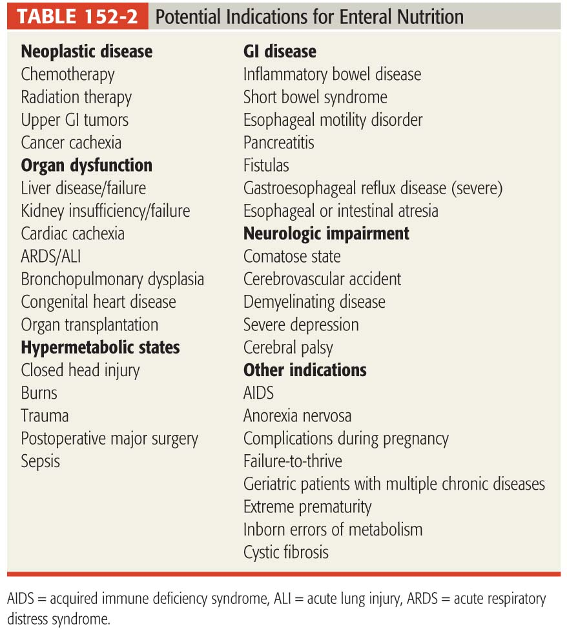
Summary of Indications
Kumpf VJ. In Pharmacotherapy, 10th edition, 2011.

Slide 38
EN Routes of Administration
Mouth to stomach
Orogastric: nasal/facial trauma or sinusitis
Nasogastric (NG): most common (short term)
Nasoduodenal: smaller, clog easily
Nasojejeunal: past 4th section of duodenum
Past the ligament of Treitz
Gastrostomy (G tube), PEG tubes: placed through abdominal wall for long-term feeding
Jejeunostomy (J tubes): through abdominal wall for immediate post-op. post-injury feeding
Nose to __
Hole in gut
Notes:
The ligament of Treitz is located at a very important junction point in the gastrointestinal cavity. Its location marks the point at which the first section of the small intestine ends and the second section starts. If its location is disturbed in any way, difficulties in both the small intestine and in the gastrointestinal cavity can result. The most severe of these is superior mesenteric artery syndrome, which results in the third section of the small intestine being compressed, causing a potentially life-threatening condition.

Slide 39
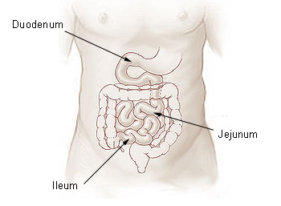
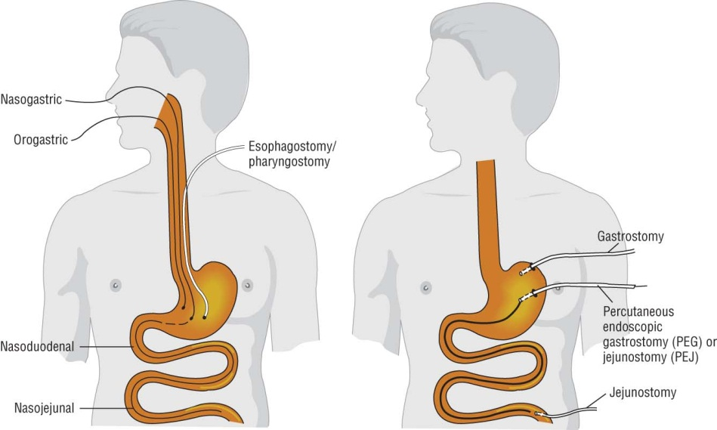
Routes of Enteral Feeding
Anatomic Locations
Types of Tubes
www. training.seer.cancer.gov/ss_ module07...anatomy.html
Kumpf VJ. In Pharmacotherapy, 8th edition, 2011.
Notes:
28:00

Slide 40
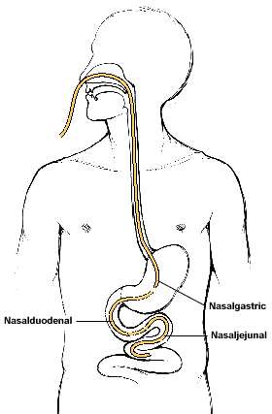
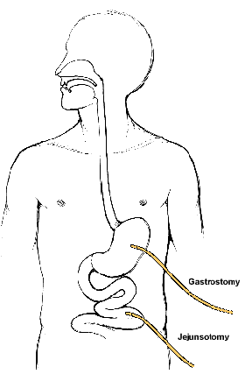
Nasoenteric versus Enterostomy
Notes:
29:00

Slide 41
Deciding on Enteral Access
Short-term or long-term?
This decides whether nasal used or ostomy placed
What regimen are we using?
Continuous: either is fine (preferred with duodenal)
Used in coma b/c pt has to be continuously connected. Coma is ok
Gastric: better for bolus
Intestinal: better for cyclic
Cyclic tx 12 hrs at a time
Patient parameters
Surgical candidate?
Visibility of tube a concern?
Notes:
29:40

Slide 42
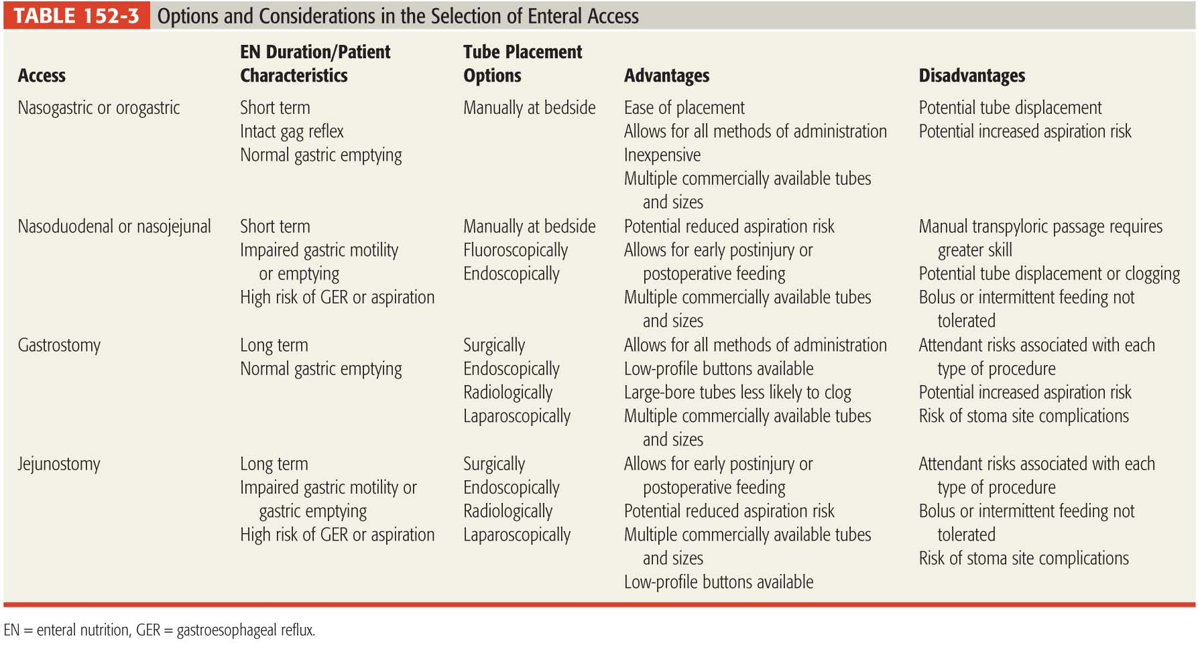
Enteral Access Options
Kumpf VJ. In Pharmacotherapy, 10th edition, 2011.
Notes:
34:15

Slide 43
Delivery of Enteral Nutrition
Four methods of administration
Gravity: no pump; infuse into stomach
Not used in inpatient settings
Continuous (over 24 hrs) via enteral feeding pump
Pros: Reduced risk of aspiration compared with bolus
Cons: always in bed
Must be used for duodenal/jejeunal feeds
Cyclic: continuously over 10-12 hours/day
Bolus: 100-300 ml over 30-60 mins q 4-6h
Only used for feeding tubes ending in stomach
Pros: easy on pancreas
Cons: risk of aspiration
Notes:
34:20

Slide 44
Developing an EN Regimen
Select formula on
Calorie/nutrient/fluid requirements or restrictions
Extent of impaired digestion and absorption
Choose a formula and assess calories per ml
Determine infusion rate (in ml per hour)
Ensure protein needs are being met
Ensure patient receives 1 ml of water for every calorie given
Notes:
36:50

Slide 45
Example of Calculating an EN Regimen
Steps | Calculation Guide | Example
Determine caloric requirements | Use 25-30 kcal/kg/day or Harris-Benedict equation | 60 kg patient multiplied by 25 kcal/kg/day = 1500 kcal
Choose a formula; assess calories per milliliter | Can be 1, 1.2, 1.5, or 2 kcal/ml | Example: TempleCal is 1 kcal per ml, so 1500 kcal = 1500 ml
Determine infusion rate | Volume of EN formula/24 hrs | 1500 ml/24 hr = 62.5 ml/hr
Ensure protein needs are met (in grams per kilogram) | Read the label to determine protein amount in formula | TempleCal provides 45 g of protein per liter, so 1500 ml = 67.5 grams of protein; divide 67.5 g by 60 kg bodyweight and patient is getting 1.1 grams per kg
Make sure patient gets 1 ml of water for each calorie | Read the label to determine water amount in formula | TempleCal has 830 ml of water per liter; 1500 ml TempleCal = 1215 ml of water. Patient needs total 1500 ml of water, so need 250-300 ml additional water divided as q6h flushes
Notes:
39:00

Slide 46
Enteral Formula Categories
Polymeric: not broken down food
Monomeric: broken down food to monomers
Over 100 formulas commercially available
Polymeric formulas most common
Intact protein (as AAs), carbohydrates (as dextrose), and fat (as lipids)
Require a functional GIT for digestion and absorption
Monomeric (a/k/a monomeric or predigested) formulas
Partially hydrolyzed protein, carbohydrate, fat
Require less digestive and absorptive capability
Notes:
42:00

Slide 47
Formulations
Respiratory:
Break down carbs, release CO2
When choosing a formula, look at several parameters:
Caloric density
Range from 1-2 kcal/ml
Fiber content
For constipated patients
Cause gas/bloating
Osmolality
See higher osmos with higher kcal/ml formulas
Disease-specific forms
Renal: concentrated for fluid restriction; ↓PRO
Respiratory: more fat, less carbs (↓ CO2 ?)
DM: less carbs, more fiber
Hepatic: branched chain AAs (controversial)
“Stressed”: immunomodulators (i.e., glutamine)
Notes:
44:36

Slide 48
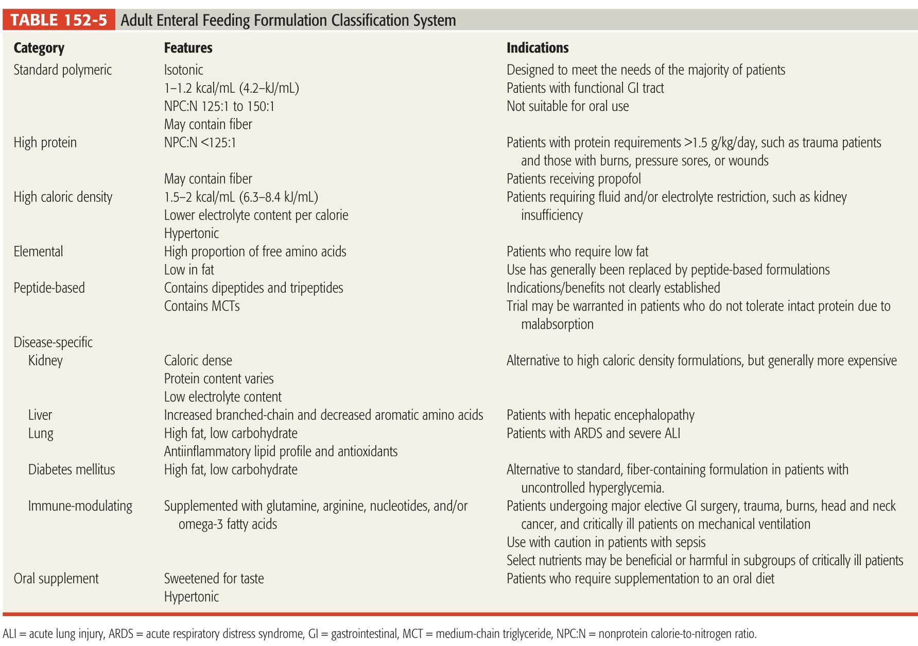
Classes of Enteral Formulas
Kumpf VJ. In Pharmacotherapy, 8th edition, 2011.

Slide 49
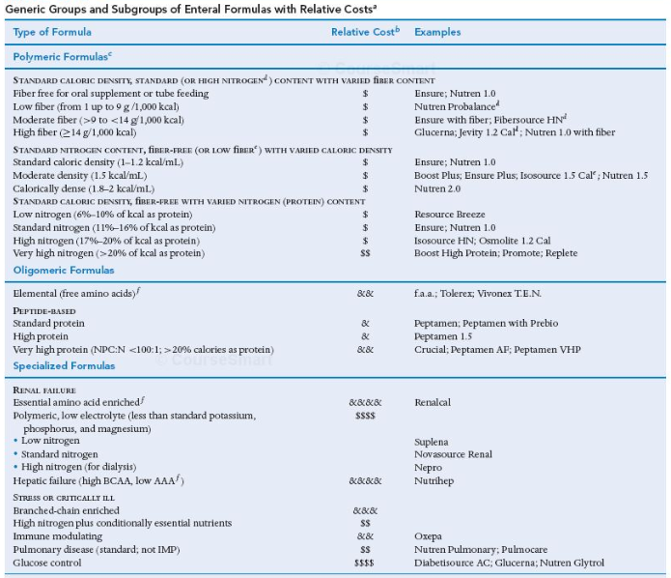
Examples of EN Formulas
Rollins CJ, Baggs JH. In Applied Therapeutics, 10th edition, 2013.
Notes:
48:30

Slide 50
Drug-Nutrient Issues
Drugs down the tube:
Flush with water
Liquid dosage forms are preferred!!!
Dilute with SW for irrigation prior to flushing
Flush tube with 20 ml water before/after meds
Acidic solutions are very likely to occlude tubes
Solid dosage forms
Must be crushed and mixed with water
Capsules should be dissolved first
Not feasible with ___PPI____________________
Notes:
49:15

Slide 51
Drug Issues with Enteral Feedings
Direct interactions
Fluoroquinolones: Ca binding
tetracycline Ca binding
levothyroxine affects absorption
Alteration in bioavailability
Warfarin, phenytoin, bisphosphonates
Adhesion to feeding tube
PPI capsules
Clogging of tube
PPI capsules
Dickerson RN. Nutr Clin Pract 2010;25:646-52.
Notes:
51:20

Slide 52
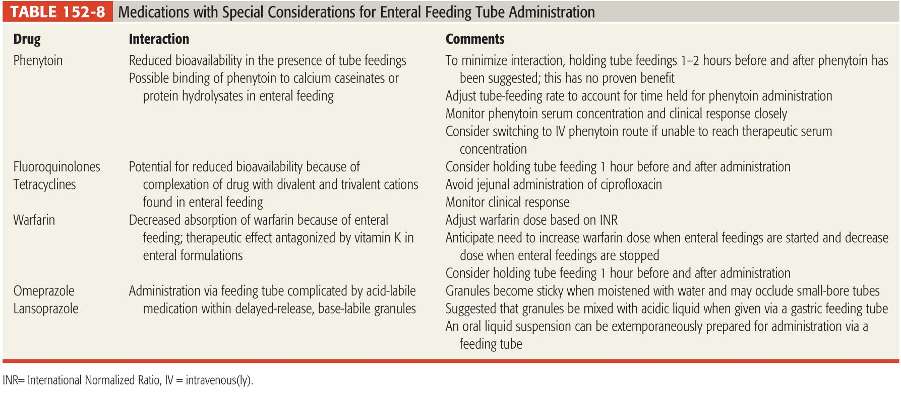
Key Drug-Nutrient Interactions
Kumpf VJ. In Pharmacotherapy, 10th edition, 2011.

Slide 53
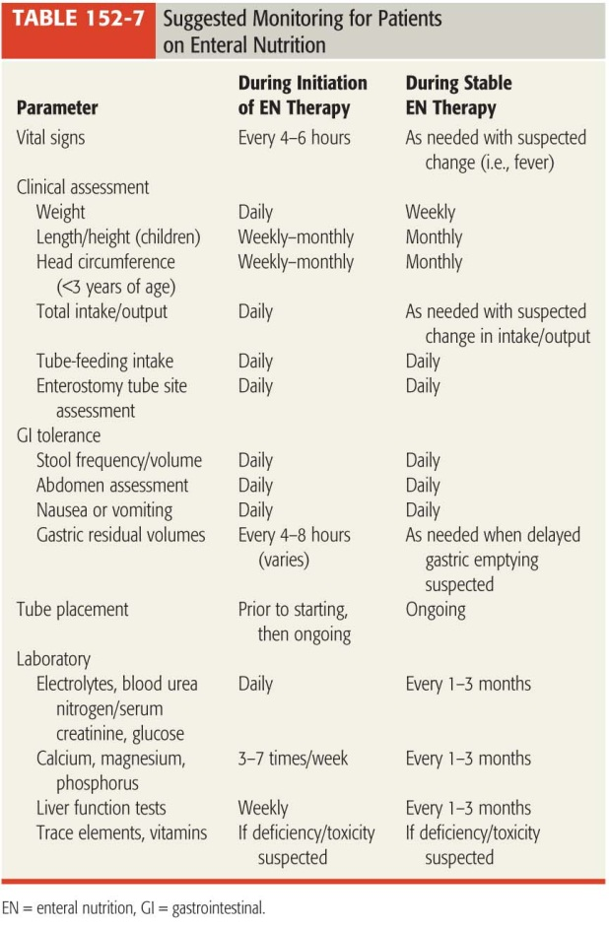
Monitoring Plan for Enteral Feedings
Kumpf VJ. In Pharmacotherapy, 10th edition, 2011.

Slide 54
Enteral Nutrition Complications
Aspiration
Highest risk with gastric feeds
Complications: pneumonia, death
Treatment:
Keep head of bed elevated @ 30-45 degrees
Monitor gastric residuals
Hold feeds if residuals are > 250 – 500 mL
Titrate to goal at slower rate (20 ml/hr); advance as tolerated
Decrease bolus size of feeds
Consider metoclopramide
Post-pyloric tube placement

Slide 55
Enteral Nutrition Complications
GI complaints
Diarrhea (21-72% of patients)
Fiber content, lactose content, malabsorption
High osmolality feeds, high rate of administration
Clogged tube
Flush before/after feeds
Flush before/between/after medications
Warm water flushes
Pancreatic enzymes
Sodium bicarb flushes
Cola flushes

Slide 56
Enteral Nutrition Complications
Metabolic complications
Hyperglycemia
Dehydration
Watch for hypernatremia
Refeeding syndrome
Electrolyte abnormalities
Miscelleaneous
Improper tube placement/dislodgement
Nasopharyngeal discomfort, sinusitis

Slide 57
Summary: Enteral Nutrition
Determine best product based on needs
Educate patient on
Fluid requirements
Drug interactions
Monitor regularly
Residuals
Labs (especially glucose, sodium)
Wound healing (good healing = good nutrition )

Slide 58
Parenteral Nutrition

Slide 59
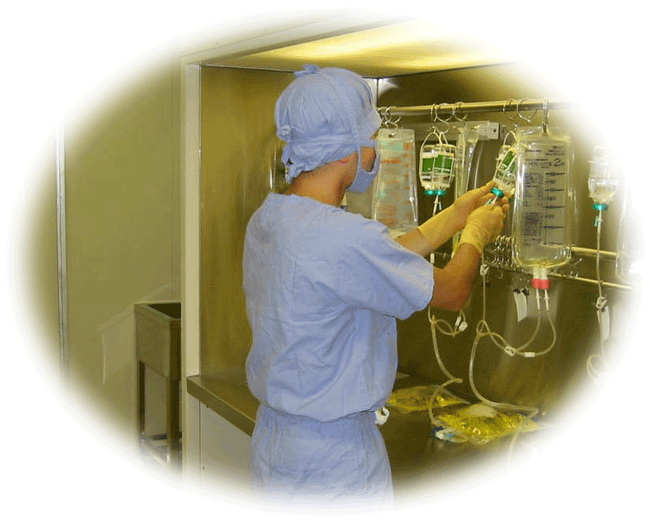
Parenteral Nutrition (PN)
Provision of nutrients intravenously
Indicated when patients cannot meet nutritional needs by oral or enteral feedings
Patient specific formulas or “recipes”
Based on nutritional status and disease

Slide 60
Parenteral Nutrition
Indications for PN:
GI tract non-functional for >7 days
Diffuse peritonitis
Intestinal obstruction, paralytic ileus
Intractable vomiting/diarrhea (>7 days)
Perioperative
GI tract ischemia
Severe malabsorption &/or short gut syndrome
Rollins CJ. Applied Therapeutics: The Clinical Use of Drugs. Koda-Kimble. 8th Edition
A.S.P.E.N Board of Directors and the Clinical Guideline Task Force. Guidelines for the use of parenteral and enteral nutrition in adult and pediatric patients. JPEN 2002;26:9SA-12SA.
Notes:
Diffuse peritonitis – inflammation of the peritoneum (lining of the abdominal cavity) which is generally considered a surgical emergency and can lead to infection, abscess formation
Short bowel syndrome is a malabsorption disorder caused by either the surgical removal of the small intestine or the loss of its absorptive function due to diseases. In healthy adults, the small intestine has an average length of approximately 6 meters (20 feet). Short bowel syndrome usually appears when there is less than 1.8 meters (6 feet) of the small intestine left to absorb sufficient nutrients.

Slide 61
Parenteral Nutrition Routes of Administration
 | Central Administration (TPN) | Peripheral Administration (PPN)
Where | Large central vein | Small peripheral vein
Duration | Long term | Short term
Osmolality | High | Low (<900 mOsm/L)
Calories | Use in patients with large calorie requirement | Use in patients with smaller calorie requirement
Max % | --------- | D10%, Protein 5%
Volume | Smaller | Larger
Rollins CJ. Applied Therapeutics: The Clinical Use of Drugs. Koda-Kimble. 8th Edition
Notes:
Solutions greater than 900 mOsm/L will cause vein irritation and potentially thrombophlebitis, which may necessitate changing of access sites.

Slide 62
Nutrient Components
 | Protein | Carbohydrate | Lipid
Kcal provided | 4 kcal/g | 3.4 kcal/g | 9 kcal/g varies with formulation
Normal Reqmt. | 15% of calories 0.8 – 2.0 g/kg/d | 60-70% of calories Max 5mg/kg/min | 25% of calories 1- 1.5 g/kg/d Max 2.5g/kg/d
Uses | Build muscle; build tissue; repair wounds | Energy source | Energy source; hormone synthesis, cell membrane synthesis; immune function; platelet function
Availability | 5-15% solutions | D70W Dextrose 70% | 10, 20, 30% solutions
Notes:
% to total
10% protein (grams)
20% lipids?

Slide 63
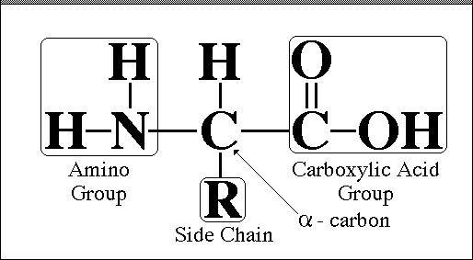

Nutrient Needs Protein
Dose grams/kg/day
Protein requirements based on nutrition status, disease states and clinical condition
Amino acids are the source of protein in nutritional supplementation
Used in tissue synthesis and repair
Not utilized for basic energy
Rollins CJ. Applied Therapeutics: The Clinical Use of Drugs. Koda-Kimble. 8th Edition
Notes:
Nitrogen is the building block of cell structure, and is used to produce enzymes, peptide hormones, and serum proteins.
Important Note- if the patient is not receiving enough calories from the other sources (dextrose and fat) the body will begin to use protein for energy rather than tissue repair and growth. The body may even begin to break down muscle stores for energy during periods of starvation.

Slide 64
Nutrient Needs Protein
On exam: pt has renal problems
Stress = ventilator, trauma
Calories Provided: 4 kcal/g protein
Average Protein Requirement = 0.8 g/kg/day
Modify for metabolic stress
Modify for necessary disease states
Increased Requirement
Minor stress | 1-1.2 g/kg/d
Moderate stress | 1.5 g/kg/d
Severe stress Post-op or in bed | 1.5-2 g/kg/d
Dialysis/CRRT | 1.2-2.5 g/kg/d
Decreased Requirement
CKD without dialysis | 0.6-1 g/kg/d
Severe liver failure +/- HE | 0.5-1.5 g/kg/d
Notes:
The final by-product of protein metabolism is the formation of urea, a toxic substance if not eliminated from the body. In patients with renal failure, urea is not filtered appropriately and can accumulate causing toxicity.
In hepatic failure, the liver is unable to breakdown and remove aromatic amino acids, thought to contribute to hepatic encephalopathy. In severe liver failure, protein restriction has been shown to be beneficial in helping symptoms of hepatic encephalopathy. Patients with severe hepatic failure and encephalopathy should be on protein restricted diets and receive less than normal protein until their response is seen.

Slide 65
Nutrient Needs Carbohydrates
Primary energy source in supplemental nutrition
Necessary to prevent the breakdown of skeletal muscle and protein
Carbohydrates should consist of about 60% of total calories
Provided as dextrose
Usually from D70W (70% Dextrose in water)
LIMIT: do not infuse more than 7 g/kg/day OR 5 mg/kg/min

Slide 66
Nutrient Needs Lipids
Primary energy source in supplemental nutrition
Used in the synthesis of steroid hormones, prostaglandins, thromboxane, and as structural components of cell membranes
Maintain cellular integrity, PLT function, and proper wound healing
Most commonly infused separately, but may be admixed with protein and dextrose in one infusion
Run over 12-24 hours
Klein S and Jeejeebhoy KN. Sleisenger & Fordtran’s Gastrointestinal and Liver Disease, 7th edition.
Notes:
Egg phospholipids are used as an emulsifying agent and glycerol is used to make the emulsion isotonic.

Slide 67
Nutrient Needs Lipids
Lipids should compose 20-25% of total calories
Calories Provided: 9 kcal/g
Calories Provided in available IV formulations:
10% solution: 1.1 kcal/mL
20% solution: 2 kcal/mL
Available as 250 or 500 ml bottles
Cannot exclude lipids from diet!!!
Minimum administration = 2-3 times per week
Concerns for EFAD
Notes:
Lipids are essential to the body. After just 7 days of a non-lipid diet, patients begin to exhibit s/sx of Essential Fatty Acid Deficiency (EFAD). EFAD is the result of deficiency of linoleic acid and arachadonic acid, which are considered essential in humans. Linoleic acid cannot be synthesized by the body. EFAD is characterized by rash, dry, scaly skin,

Slide 68
Nutrient Needs Lipids
Most Commonly used Lipid Formulations
Lipid Product | Calories provided | Total kcals
10% 250 mL | 1.1 kcal/mL | 275 kcals
10% 500mL | 1.1 kcal/mL | 550 kcals
20% 250 mL | 2 kcal/mL | 500 kcals
20% 500 mL | 2 kcal/mL | 1000 kcals

Slide 69
Parenteral Nutrition Additives
Electrolytes - necessary to maintain cellular function, acid-base balance, nerve conduction & water balance
 | Maintenance Dose* *Normal renal function | Source
Sodium (Na⁺) | 60-150 mEq/day | NaCl, NaPO₄, Na acetate
Potassium (K⁺) | 60-150 mEq/day | KCl, KPO₄, K acetate
Chloride (Cl⁻) | 60-150 mEq/day | NaCl or KCl
Acetate | 25-120 mEq/day | Na acetate or K acetate
Calcium (Ca⁺⁺) | 4-14 mEq/day | Ca gluconate (4.7mEq/10mL)
Magnesium (Mg) | 8-24 mEq/day | Mg sulfate (4mEq/mL)
Phosphorous (PO₄) | 20-60 mmol/day | NaPO₄ or KPO₄
A.S.P.E.N Board of Directors and the Clinical Guideline Task Force. Guidelines for the use of parenteral and enteral nutrition in adult and pediatric patients. JPEN 2002;26:9SA-12SA.
Klein S and Jeejeebhoy KN. Sleisenger & Fordtran’s Gastrointestinal and Liver Disease, 7th edition.

Slide 70
Parenteral Nutrition Additives
Vitamins
Usually provided as a multivitamin injection
1-5mL per PN bag
Characteristic yellow color
Elements
May or may not be added
Selenium, zinc, chromium, manganese
Insulin
Based on blood glucose readings
Increased requirement in diabetics, critically ill, high dextrose content

Slide 71
Steps to Composing a PN Formula
Determine caloric requirements
Determine fluid requirements
Determine protein requirements
Remember concurrent disease states and adjust accordingly
Know how many calories protein is contributing
Calculate remaining calories
About 20-30% as lipids and the rest as dextrose
Ensure formula final concentrations are OK

Slide 72
Key Concept
You MUST be able to convert
kcals
volume
grams
% solution

Slide 73
Complications of PN Infection
Infection
Predisposed to infectious complications
Hospitalization, bacterial translocation, use of broad spectrum antibiotics
Catheter-related infections, bacteremia
Common organisms:
Signs/symptoms/monitoring:
Staphylococcus, Klebsiella and Candida
25% may be polymicrobial
Fever/chills, leukocytosis, hyperglycemia,
hypotension, altered mental status
Marra AR. J Clin Gastroenterol 2007;41(1):19-28.
Notes:
Infectious complications are the most common complication of IV nutrition supplementation. Infections are common partly because many of the patients receiving PN are predisposed to infection- decreased immune function secondary to malnutrition, critically ill in the ICU or hospital, s/p trauma or surgery which also puts them at risk. Catheter related infections are defined as growth isolated from the catheter tip and peripheral blood cultures. Daily access to the site of administration, open port, close to skin (staph common) increases likelihood that skin microbes can contaminate the catheter and blood. PN is a great breeding ground for bacteria and yeast secondary to it’s high glucose and fat medium. Monitor for s/sx of infection: fever, leukocytosis, BCX, catheter redness, swelling, purulent drainage
Hyperglycemia common with high dextrose contents of PN. Critically ill patients are more susceptible to hyperglycemia because of infection, stress response, steroid use, etc. Treat by decreasing glucose in PN and/or adding insulin
Refeeding syndrome is severe electrolyte and fluid shifts associated with metabolic abnormalities in malnourished patients undergoing refeeding. Characterized by hypophosphatemia, hypomagnesemia, and hypokalemia. Shift from fat metabolism to glucose metabolism when starting PNUsually occurs when the patient is severely depleted and repleted very quickly. Electrolytes move from extracellular space to intracellular space to replete the stores that have been depleted.

Slide 74
Complications of PN Infection
Microbiology of TPN Infections
Organism | Number as %
Gram Positive Organisms Staphylococcus Enterococcus | 55%
Gram Negative Organisms Klebsiella E.Coli | 22%
Fungus C. parapsilosis C. glabrata C. albicans | 22%
*Coagulase Negative Staphylococcus 103; Staphylococcus aureus 33; MRSA 15
**All Enterococcus faecium species were Vancomycin resistant 5
Marra AR. J Clin Gastroenterol 2007;41(1):19-28.
Notes:
Descriptive, observational epidemiologic study of long term TPN patients (>6 months)
47 patients, 313 organisms cultured during the evaluation period (1981-2005)
79% of patients had >1 infection while on TPN, 24% polymicrobial,
Most common pathogen was CNS (34%)
11 deaths (4 due to infection, 4 due to IV drug use)

Slide 75
Complications of PN Infection
Dextrose/Amino Acid combinations
_______ risk of infection
Run over 24 hours
Lipid formulations
_______ risk of infection
Run over 12 hours
Combination Dextrose/AA/Lipids
____________ risk of infection
Run over 24 hours
Low
High
Intermediate
Notes:
Dex/AA solutions PN are not conducive to growth of many organisms because of their high osmolarity >2000mOsm/L and acidic pH.
Lipid formulations are isotonic and have a normal physiologic pH, providing an optimal growth medium for organisms.

Slide 76
Complications of PN Metabolic complications
Hyperglycemia
Monitor daily
Secondary to many causes commonly found in hospitalized patients
Secondary to excessive dextrose load
Monitor: ___________
Treatment
Begin at ½ strength dextrose and slowly increase to goal over 24-48 hours
Insulin
Notes:
Hyperglycemia may also be secondary to several other causes that are very commonly found in hospitalized patients: steriods, infection, stress, diabetes, excessive dextrose administration.
In one clinical trial, only 7% of patients displayed hyperglycemia who were given < 5mg/kg/min where 49% of patients developed hyperglycemia that were receiving > 5mg/kg/min

Slide 77
Complications of PN Refeeding Syndrome
Starved Patient
Refeeding Patient
↓ Glucose intake
↑ Glucose intake
↓ Insulin release
↑ Insulin release
↓ Electrolyte intake
↑ Thiamine utilization
↓ Thiamine, vitamin intake
↑ Extracellular shift
↑ Electrolyte intracellular shifts
Extracellular
Extracellular
Glucose
Intracellular
Intracellular
K⁺
Glucose
K⁺
K⁺
Glucose
K⁺
Mg⁺⁺
Mg⁺⁺
PO₄⁻
Mg⁺⁺
PO₄⁻
PO₄⁻
Mg⁺⁺
PO₄⁻
Notes:
Potasium is the major intracellular Cation, Magnesium is the major divalent intracellular cation
PO4 is the major intracellular anion.
Electrolytes are shifted intracellularly with insulin secretion
Furthermore, potassium is used to help rebuild muscle stores
Magnesuim is used in the synthesis of lean body tissue
Phos is used for ATP generation in the liver and skeletal muscle.

Slide 78
Complications of PN Metabolic complications
Refeeding syndrome
Intracellular shift of electrolytes
↓ PO₄⁻, K⁺, Mg⁺⁺
Complications
Neurologic (weakness, seizure, parasthesia, ataxia)
Muscular (weakness, myalgia)
Cardiac (arrrhythmia, ↓ cardiac contractility, ↑/↓ volume)
Altered mental status
Treatment/Prevention
Slowly introduce dextrose
Replete electrolytes prior to nutritional support
A.S.P.E.N Board of Directors and the Clinical Guideline Task Force. Guidelines for the use of parenteral and enteral nutrition in adult and pediatric patients. JPEN 2002;26:9SA-12SA.
Notes:
Term first described in WWII with holocaust victims that were severely malnourished. Complications included hypertension, seizures, cardiac complications, coma, and death. These complicati

Slide 79
Complications of PN
Hypertriglyceridemia
Secondary to lipid infusions
Pancreatitis = major concern
Monitor: Triglycerides
Concern with Triglycerides > 400
Treatment
Administer lipids BIW-TIW

Slide 80
Complications of PN
Hepatic dysfunction
Steatosis (fatty liver), cholestasis
Relatively common after 2-3 weeks of PN
Mildly elevated AST/ALT
Rarely progresses to hepatic failure (cholestasis)
Overfeeding with dextrose &/or lipids
Monitor: __________________
Treatment:
Decrease dextrose &/or fat content
Continuous monitoring
AST/ALT (acute), TB (chronic), ALP
A.S.P.E.N Board of Directors and the Clinical Guideline Task Force. Guidelines for the use of parenteral and enteral nutrition in adult and pediatric patients. JPEN 2002;26:9SA-12SA.
Notes:
Hepatic enzymes generally decrease back to normal if the PN is discontinued

Slide 81
Complications of PN
Drug/Nutrient/Electrolyte Compatibility
Biggest Risk: Calcium and Phosphorus
May form an insoluble precipitate which can be life-threatening; to avoid precipitate formation
Keep calcium final concentrations less than 6 mEq/L and phosphate less than 30 mM/L
Use calcium gluconate NOT calcium chloride
Final concentrations of AAs should be 2.5% -10%
Keep refrigerated and use within 24 hours
PO4 in first, mix others, Ca last; LIMIT MED ADDITIVES
Use a 1.2 micron filter when administering
INSPECT FINAL FORMULA
Notes:
1630

Slide 82
Monitoring Parameters
Daily | 2-3 times per week | Weekly
*** Check for Drug Incompatibility AT ALL TIMES *** Monitor for precipitate
Vital signs
Fluid balance
(I’s and O’s)
Electrolytes
(Chem-7, Ca, Mg, Po4)
Blood Glucose
CBC
Weight
Prealbumin
Triglycerides
AST/ALT, TB

Slide 83
Cases for Next Class

Slide 84
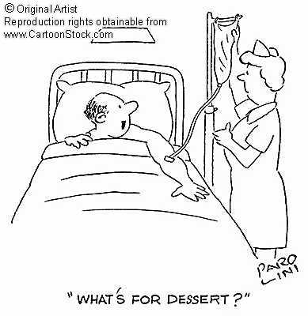
Questions?

